Slide 1
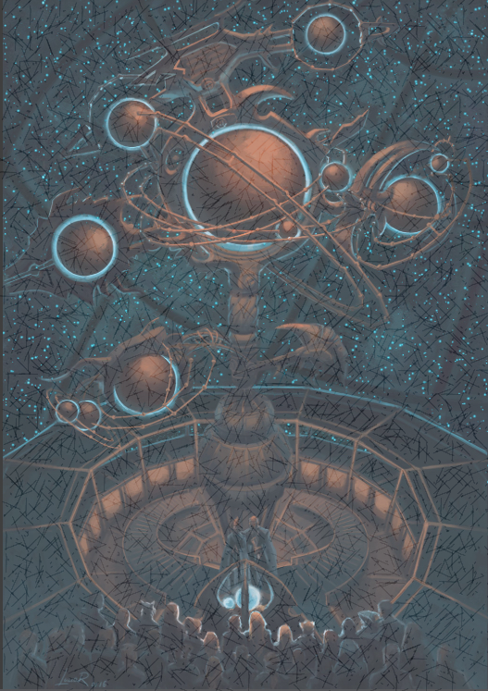
Orrery
Our Goals:
We wanted to create an interactive orrery web app that would allow people to easily predict effects of near-earth objects.
G sim earth
This would mean that people would be able to more easily detect and predict impacts and help save lives.

Slide 2
Orrery
G sim earth
Our Goals:
We wanted to create an interactive orrery web app that would allow people to easily predict effects of near-earth objects.
This would mean that people would be able to more easily detect and predict impacts and help save lives.

Slide 3
Orrery
Our Goals:
We wanted to create an interactive orrery web app that would allow people to easily predict effects of near-earth objects
This would mean that people would be able to more easily detect and predict impacts and help save lives
G sim earth
How we did this:
For a short period of time (initially 0.2s), we calculated the change in velocity of the asteroid due to the force of gravity The change in velocity is proportional to the mass of the sun (or earth),
and Inversely proportional to the square of the distance In other words, the asteroid is more strongly affected by a bigger mass, and very strongly affected by the distance of the asteroid from the sun (or earth)
From the new velocity we calculate the new position of the asteroid
Then the process is repeated for the next increment of time

Slide 4
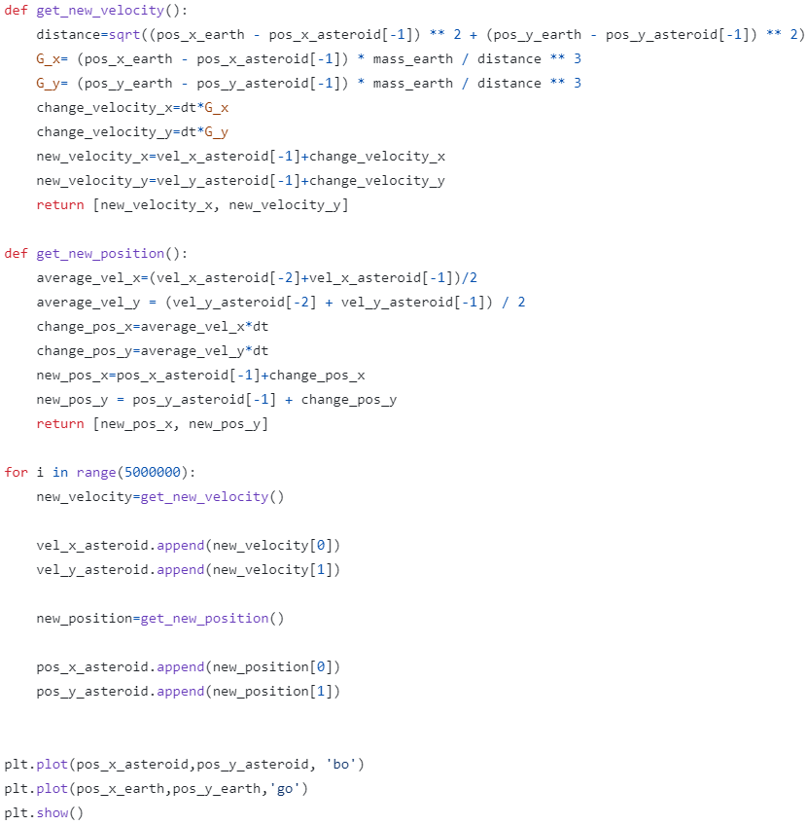
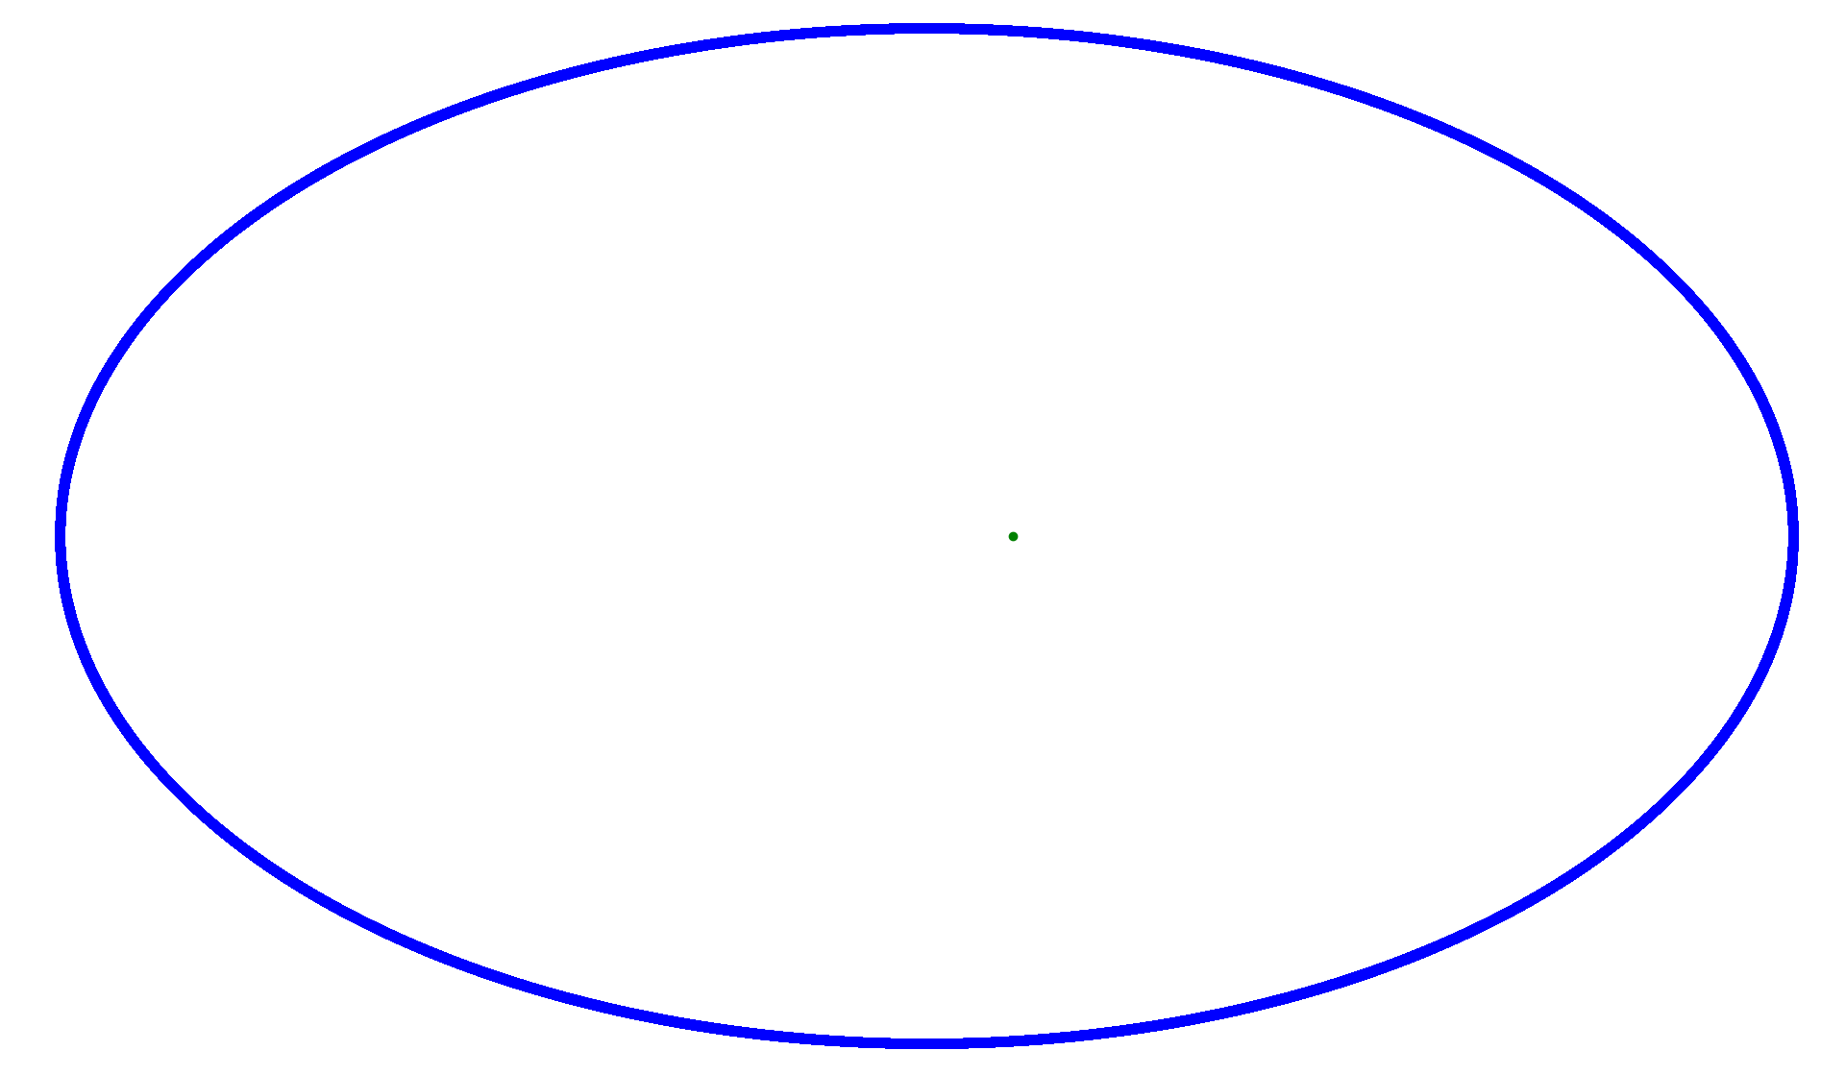
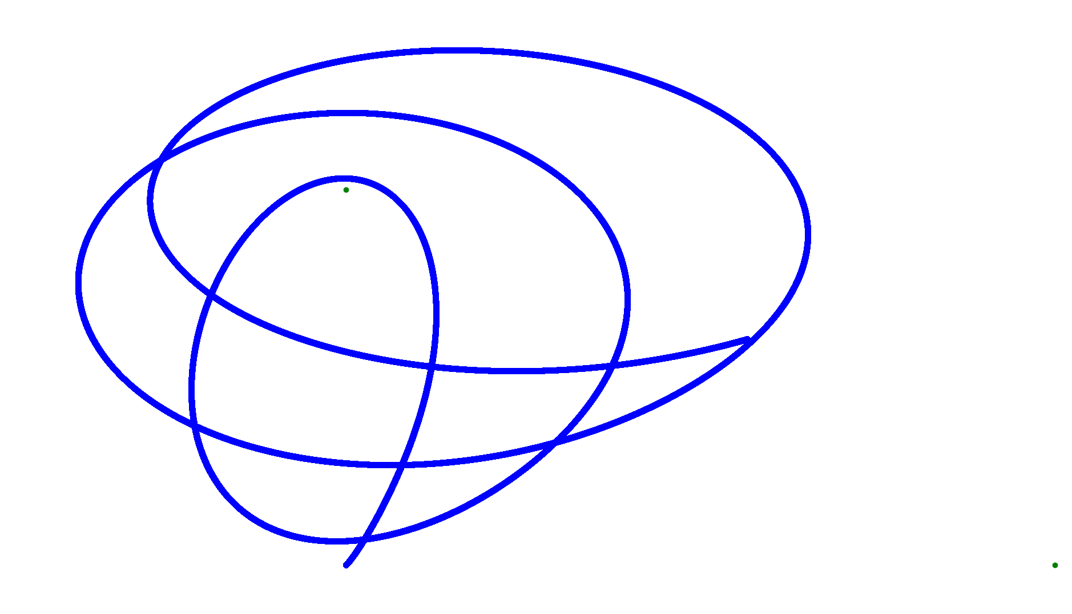


Implementing into Python:
This code was to predict the path of an asteroid with a single planetary body to see what would happen with different variables.
Stable orbit around a planetary object using our code.
Could have variables changed for different asteroids and planets if needed.

Slide 5
Implementing into Python:
As can be seen. We further developed the code to be affected by the sun as well as Earth. The asteroid follows a bizarre trajectory! However, we were please to see that the asteroid seems to be attracted to both the earth and the sun as it should be. The errors may come about due to mistakes in our programming, or the inherent loss of precision by incrementing the calculation in short periods of time.
This calculation was completed in python with the following script: The results were plotted using matplotlib on python.
Implementation in C# and Unity: The calculation was also completed in C# with the following script:
Stable orbit around a planetary object using our code.
Could have variables changed for different asteroids and planets if needed.

Slide 6


Implementing in C#:
We then used the base code from the python implementations to make a more visually appealing interactive web app. We did this by translating the python code to C# and using unity's web porting to make a web app.

Slide 7
